Slide 1
PRISIONER TRANSPORT
Sevier County Sheriff’s Office
Sgt. Phillip Davis

Slide 2
Search Procedures
Policy
All persons must be searched thoroughly prior to transport in police vehicles
Care should be taken to protect the dignity and self-respect of the person being searched
Items seized during a search will be preserved as evidence
Care should be exercised when searching a prisoner’s private property

Slide 3
Types of Searches
General Searches − reveal the contents of a person’s outer garments, general clothes, or hand luggage without touching the person or the luggage

Slide 4
Types of Searches (continued)
Clothing Searches – ensure the security and the safety of persons in custody
Remove the prisoner’s hat, shoes/socks, bags, or excess clothing, and search item-by-item
Empty all of the prisoner’s pockets
Check all of the seams and sleeves of the prisoner’s clothes for concealed articles
Check the inner linings of the prisoner’s clothes for evidence of damage or tampering
Remove the loose inner soles of the prisoner’s shoes
Bang the prisoner’s shoes together to loosen any hidden items
Turn the prisoner’s socks inside out

Slide 5
Types of Searches (continued)
Strip Searches – require the removal of some or all of the prisoner’s clothing to reveal contraband
If a strip search is required, the search must be conducted only in a private area of the detention center of the medical facility
The prisoner must be allowed to remain partially clothed at all times
The search must be carried out as quickly as possible
The search must be conducted by a staff member of the same sex as the prisoner

Slide 6
Types of Searches (continued)
Personal Searches
Check the prisoner’s hair, especially women with ponytails or weaves, to ensure nothing is hidden in their hair
Inspect the prisoner’s mouth and ears
Search the seams on the collar of the prisoner’s clothing
Apply light pressure, with the palms of your hands and pat over the prisoner’s torso paying particular attention to the recess of the spine until reaching the beltline
Run the up side of your palms (palms down/bladed hand) in between and underneath the breasts of female prisoners

Slide 7
Types of Searches (continued)
Personal Searches (continued)
Sweep the fingers around the prisoner’s waistline and underneath the prisoner’s belt
Ensure that the prisoner’s pockets are patted thoroughly
With straight fingers, run your hand into the crotch area of male offenders, being careful not to grope the prisoner’s genitals
Ensure that the prisoner’s pant cuffs are unrolled and patted

Slide 8
Transport of Prisoners: Vehicle Checklist
Every patrol vehicle shall be searched by the assigned officer at the beginning of that officer’s shift
Search the vehicle before and after transporting a prisoner
Search the rear seat area prior to placing a prisoner in the vehicle
Check the passenger compartment after transport for any contraband dropped by the prisoner during transport
Treat the items left in the vehicle as evidence until determined otherwise

Slide 9
Transport of Prisoners: Transport Guidelines
A maximum of two prisoners may be transported in a patrol car
Juveniles can only be transported in patrol cars
No adult may be transported with a juvenile except a parent or other adult arrested in connection with same offense
Female prisoners may be transported with male prisoners only when they are arrested during the same incident

Slide 10
Transport of Prisoners: Special Circumstances
A Prisoner Becomes Disorderly
Continue to the detention facility if the prisoner does not pose a threat to the safe operation of the vehicle
Pull over to side of road and notify dispatch if safe operation of the vehicle is at risk. Exit the vehicle and wait for help to arrive. Do not open the doors
Prisoner Communication
The prisoner shall not communicate with anyone during transport, other than transporting officer

Slide 11
Transport of Prisoners: Special Circumstances (continued)
Visual Observation
The transporting officer should be able to visually observe the prisoner at all times
Extreme care should be taken on extended trips when stopping for fuel, meals, or personal relief
An officer of the same sex should be used if transport is lengthy

Slide 12
Transport of Prisoners: Special Circumstances (continued)
Transport to a hospital or medical facility
Isolate the prisoner from other patients
Never leave the prisoner unattended
Notify hospital security
Remove restraints only if necessary for medical care
Prisoners who are sick or injured shall be examined by Emergency Medical Services (EMS) prior to transport

Slide 13
Transport of Prisoners: Special Circumstances (continued)
Transport to a hospital or medical facility (continued)
If necessary, EMS may call an ambulance for the transport of the prisoner to a medical facility. The officer will follow the ambulance, unless he or she is requested to ride with the prisoner by ambulance personnel
While being transported, a sick or injured prisoner shall be handcuffed
An unconscious prisoner shall be transported by ambulance to a hospital or medical facility

Slide 14
Transport of Prisoners: Special Circumstances (continued)
Physically and mentally handicapped prisoners
Prisoners requiring wheelchairs, crutches, or prosthetic appliances should be given special consideration when transported
The seriousness of the handicap, the mobility of the prisoner, and the circumstances of the arrest will determine the degree of physical restraint used
Mentally disturbed prisoners are to be restrained securely without causing injury. If the prisoner is violent, two or more officers will be used to transport the prisoner
If a mentally ill prisoner exhibits violent or bizarre behavior that may cause harm to himself or herself, or others, the prisoner may be transported on a stretcher in an ambulance

Slide 15
Transport of Prisoners: Restraints
All prisoners must be handcuffed, and handcuffs must be double locked
When necessary, a prisoner may be restrained with a waist belt of leg shackles
No person shall be handcuffed to a stationary object or to any part of the transporting vehicle, or be left unattended

Slide 16
Transport of Prisoners: Restraints (continued)
Officers will check the tightness of handcuffs after they are applied
Officers should be able to slip an index finger under the handcuffs on the top, bottom and sides
Officers should investigate the prisoner’s complaints that the handcuffs are too tight
Loosen the handcuffs if needed
Document the action taken in response to the prisoner’s complaint

Slide 17
Transport of Prisoners: Restraints (continued)
Handcuffs will not be removed until the prisoner is inside the detention facility
Officers will not use the “hog tie” method of maximum restraint to control an unruly prisoner
An officer will not handle another police incident while transporting a prisoner unless it is of the magnitude to place a life in jeopardy

Slide 18
Handcuffing: Safety
Remember that handcuffs can be used as a weapon
Keep the handcuffs closed at all times
Maintain full control of the handcuffs
Keep your thumb out of the way of the arm bar
Double lock the handcuffs after applying them

Slide 19
Handcuffing: Nomenclature
Chain
Rachet
Teeth
Lock

Slide 20
Handcuffing: Positioning
Handcuffing should be initiated from the 2½ tactical position
The officer should be behind the suspect with the gun side away from the suspect
The officer’s inside shoulder should line up with the suspect’s outside shoulder
Suspect
Officer
Officer
Left-handed
Right-handed

Slide 21
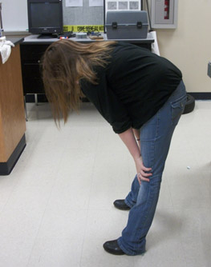
Handcuffing: Verbal Commands
“Suspect, bend over at the waist”
Make sure that the suspect is bent over at a 90-degree angle

Slide 22
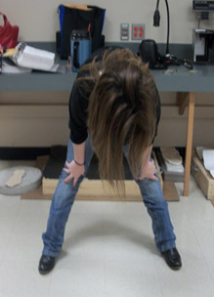
Handcuffing: Verbal Commands (continued)
“Suspect, spread your feet shoulder width apart”
The farther apart the suspect’s feet are, the better advantage you have, especially if the suspect is tall

Slide 23
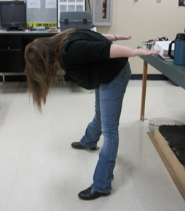
Handcuffing: Verbal Commands (continued)
“Suspect, place your hands behind your back, palms up”
Make sure the suspect’s arms are up off of his or her back and fully extended

Slide 24
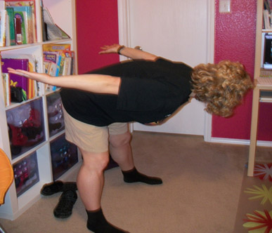
Handcuffing: Verbal Commands (continued)
“Suspect, look away from the sound of my voice”
Make sure that the suspect turns his or her head to the side that is opposite from where you are standing

Slide 25
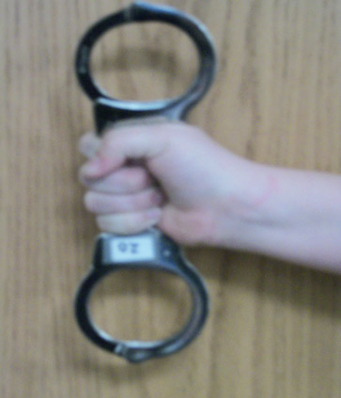
Handcuffing: Grip
Take hold of the handcuffs in your strong hand
Your hand should firmly fit between the two cuffs
Have a tight grip on the chain between the cuffs
Both ratchets should face towards your knuckles
Hold the handcuffs as if they were a gun
“Pistol Grip”

Slide 26
Handcuffing: Speed Cuffing Step One
Hold the handcuffs perpendicular to the ground
With your weak hand, grab the suspect’s hand closest to you as if you were giving the suspect a handshake
Maintain control of the suspect
Take your strong hand and place the bottom cuff on the suspect’s wrist using the “touch-push” method

Slide 27
Handcuffing: Speed Cuffing Step One (continued)

Slide 28
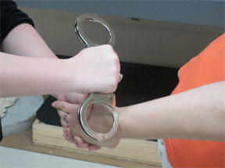
Handcuffing: Speed Cuffing Step Two
Maintain control of the handcuffs
Do not let go of the chain or cuffs

Slide 29
Handcuffing: Speed Cuffing Step Two (continued)
Reach over to the suspect’s other hand and pull it towards the already cuffed hand

Slide 30
Handcuffing: Speed Cuffing Step Two (continued)
Place the top cuff on the suspect’s other hand using the “touch-push” method

Slide 31
Handcuffing: Speed Cuffing Step Three
Check the handcuffs for fit
Make sure no more than one fingertip can fit inside the cuffs
Adjust the cuffs as needed

Slide 32
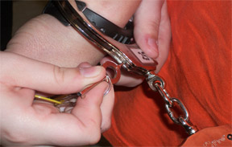
Handcuffing: Double Lock
Insert the pointed tip of the key into the hole on the side of the cuff until it clicks
Check the handcuffs to make sure that they are immobile
The cuffs should not clamp down on the suspect’s wrist

Slide 33
Phil Davis Office of Community Relations 865-755-0221 (TEXT 1st) Special Operations Center 735 Middle Creek Road pdavis@seviercountytn.gov www.seviercountysheriff.com

